Slide 1

Investigating the rate of unemployment across different demographic groups.

Slide 2
Purpose and objectives
This project aims to:
Explore changes in unemployment over the past 10 years to understand whether the labour market is progressing or deteriorating over time.
Identify whether the rate of unemployment is increasing or decreasing with time.
Identify differences in unemployment rates amongst diverse demographic groups (ethnicity, age, gender, region)
Use historical data to make informed forecasts about future unemployment trends, thi can be valuable for workforce planning and policy development.
Provide suggestions based on the analysis, including strategies aiming to address disparities and formation of potential policies.

Slide 3
Methods
Time series in Power Bi to conduct data analysis
The 6 stages of data analytics cycle employed to accomplish this project
discovery
data preparation
plan model
build model
communicate results
Deploy live

Slide 4
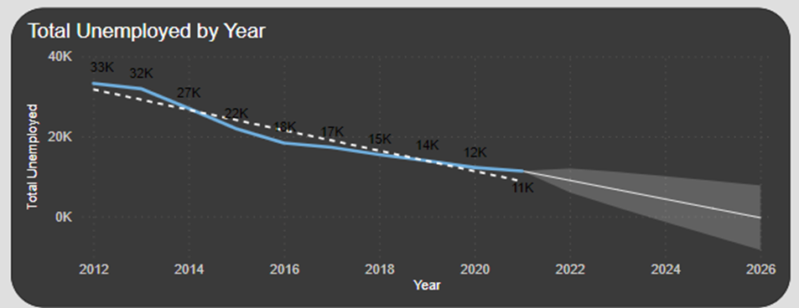
EXPLANATION OF VISUALS
The total number of people unemployed can be seen decreasing very year.
Unemployment displays a persistent trend each year
The constant pattern in the line chart indicates a seasonal influence, suggesting that certain times of the year constantly experience a decrease in unemployment
The forecast predicts that the unemployment is likely to decrease further in the future, indicating a continuation to the seasonality observed

Slide 5
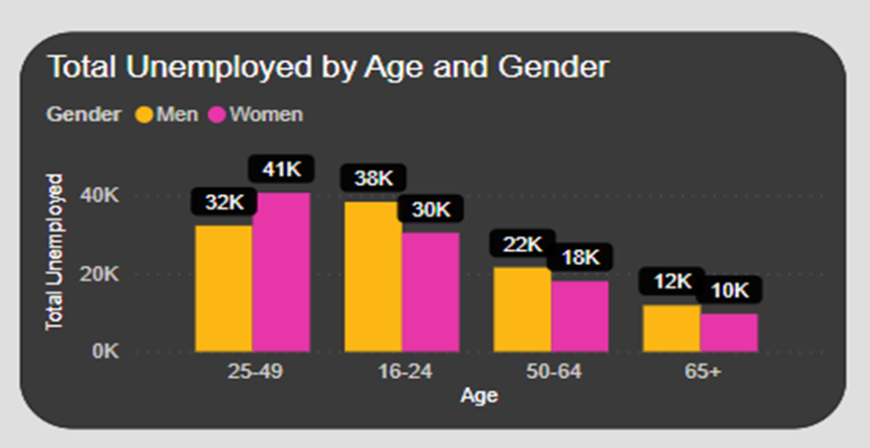
EXPLANATION OF VISUALS
Individuals around the age of 25- 49 are the highest unemployed age group based on the historical data
The group with the lowest unemployment is aged 65+ and within this age group 12k men are affected by unemployment and women being affected slightly less with a total number of 10k

Slide 6
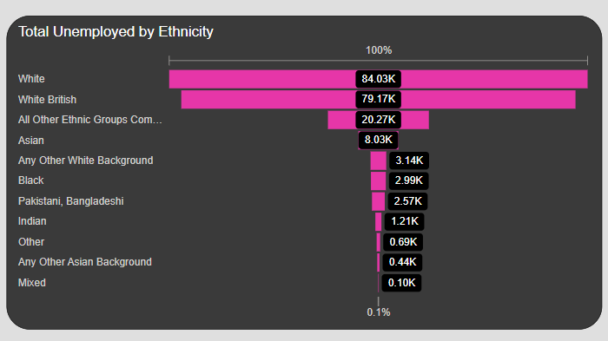
EXPLANATION OF VISUALS
The White ethnicity has the highest number of individuals unemployed, with a total number of 84.03k being unemployed
The ethnicity with the lowest unemployment has shown to be mixed, with just 0.10k individuals being unemployed

Slide 7
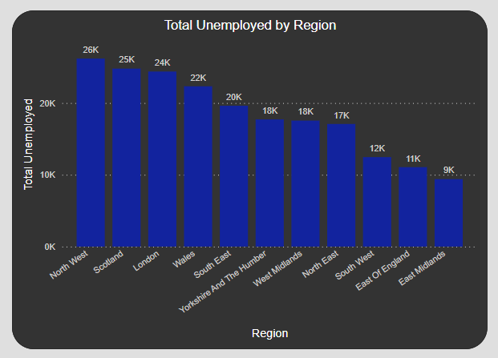
EXPLANATION OF VISUALS
Northwest has been highlighted as the region with the highest unemployment and has a total number of 26k individuals being unemployed
East Midlands has been identified as the region with the lowest unemployment in the UK, with just 9k individuals being unemployed

Slide 8
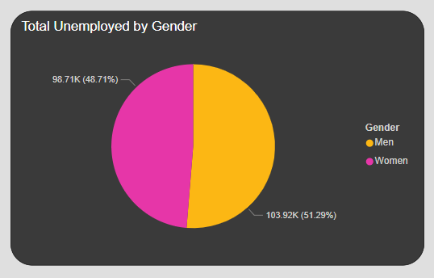
EXPLANATION OF VISUALS
The percentage of men being unemployed within the past 10 years is 51.29%, however, women are slightly less unemployed with a total of 48.71% being unemployed

Slide 9
Results
The data analysis has displayed a decrease in the rate of unemployment over time
Exploration of unemployment across different demographics has revealed variations among the groups
Differences in the rate of unemployment across different ethnicities, regions, age groups, and gender has been observed
Northwest has been identified as the region with the highest unemployment
The age group with the highest unemployment is 25-49
The White ethnicity has been identified as the ethnicity with the highest unemployment
Men are slightly more unemployed as compared to women

Slide 10
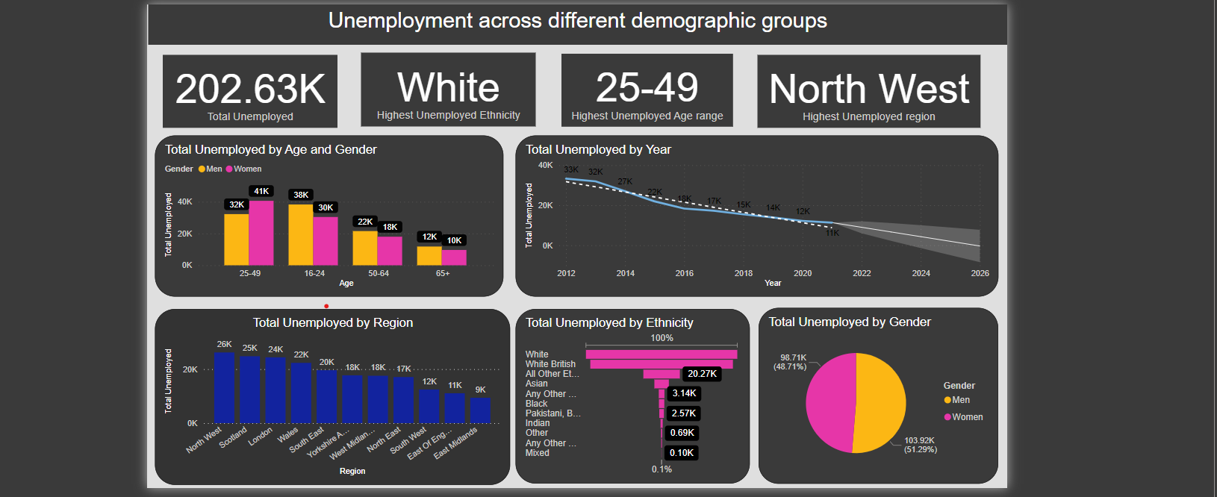
Dashboard

Slide 11
Conclusion
The Power BI visuals have indicated crucial insights and trends into the dynamics of unemployment across different demographics
The line chart has displayed a constant decrease in unemployment over the time and the forecast within the line chart has also predicted a decrease in unemployment in the future
The rate of unemployment differs across different demographic groups, emphasizing the need of policies and intervention targeting the groups with the highest rate of unemployment
To decrease the risk of unemployment in the future, it is important to design interventions and policies targeting the group of individuals with increased unemployment
Organisations should implement policies promoting inclusiveness and diversity as this will help to reduce unemployment across certain groups of people

